Slide 1
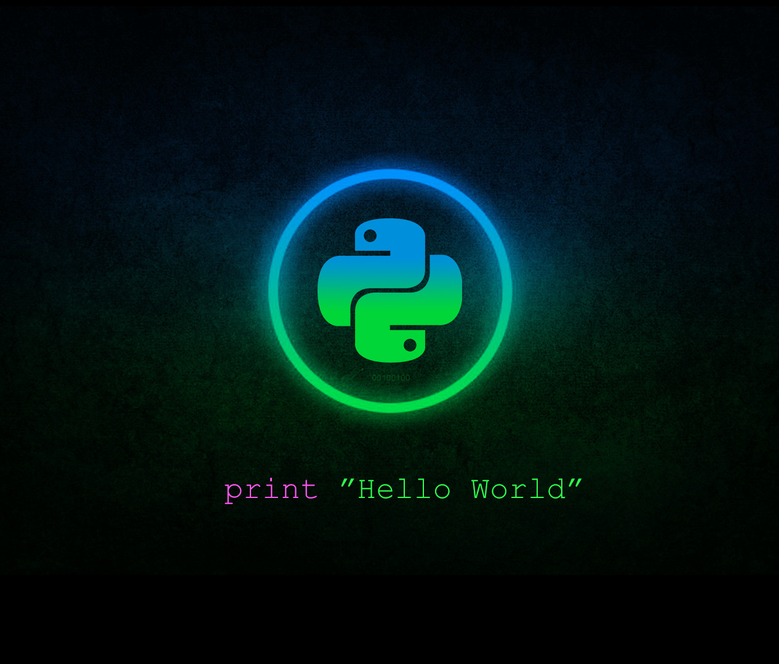



String Manipulation
Class
viii
Lab 20
Supported by
Powered By

Slide 2
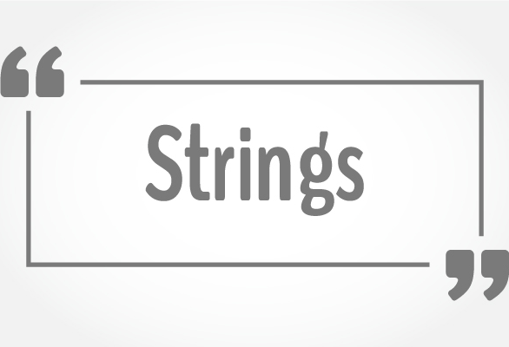
Strings
String can be declared with single quote or double quote. But there are few problems in single quoted string
Supported by
Powered By

Slide 3
Problems in Single Quote
>>> c = ‘I am a ‘student’ of class Eight’
SyntaxError: Invalid syntax
>>>
Python counts string from the first quote, when it get another quote it just stops counting string. That’s why problem arises
Supported by
Powered By

Slide 4
Solution: Uses of double quoted string
>>> c = “I am a ‘student’ of class Eight”
I am a ‘student’ of class Eight
>>>
Using double quote can fix your error
Supported by
Powered By

Slide 5
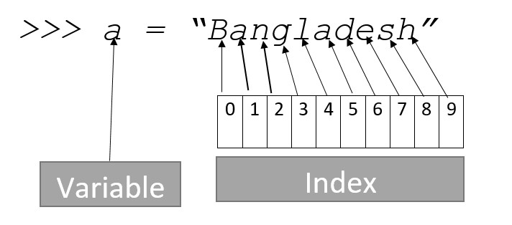
Index of String
Index starts from the number zero

Slide 6
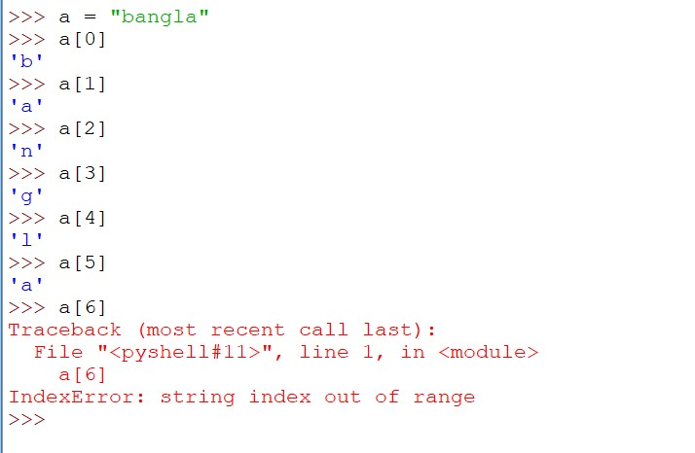
Checking Index
Error will be raised when we are checking an invalid index

Slide 7
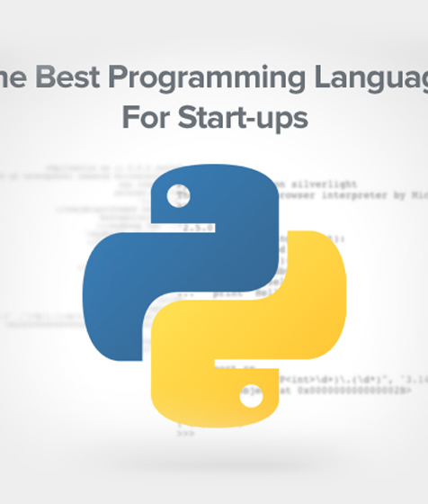
String with Variable
You can use string and variable at a same time inside the print function
>>> fruit = “mango”
>>> print (“My favorite fruit is: ”, fruit )
Supported by
Powered By

Slide 8
Join Function
You can join character among many strings
>>> fruit = “Mango ”
>>> flower = “ Rose”
>>> ‘&’.join((fruit, flower))
>>>Mango & Rose
Supported by
Powered By

Slide 9
Upper & Lower Case
>>> a = ‘apple’
>>>a.capitalize()
Apple
>>>
>>> b = “English”
>>>b.upper()
ENGLISH
>>>
>>> c = “ENGLISH”
>>> c.lower()
english
>>>
It’s too much easy to turn capital letter into small letter and vice versa.
Supported by
Powered By

Slide 10

Thank You!
You’ll learn list, tuple & set from next lab

